Slide 1
WEB 3.0
WHAT IS THE THIRD GENERATION OF INTERNET ?
WEB
A guide by Samartha Nirmal

Slide 2
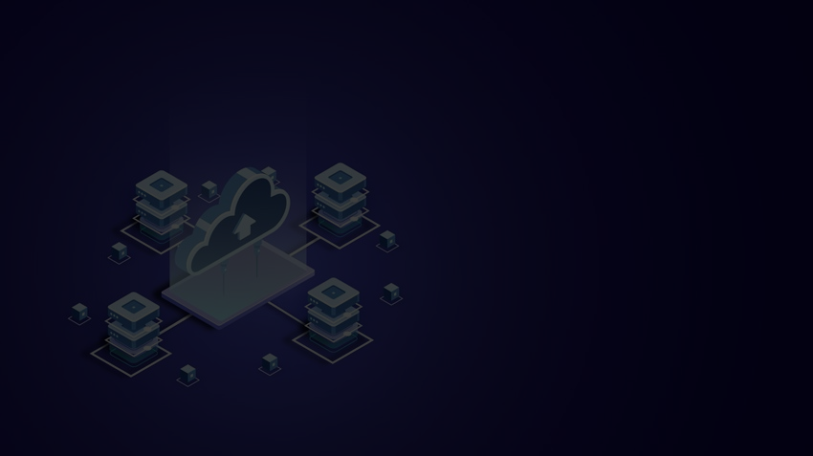


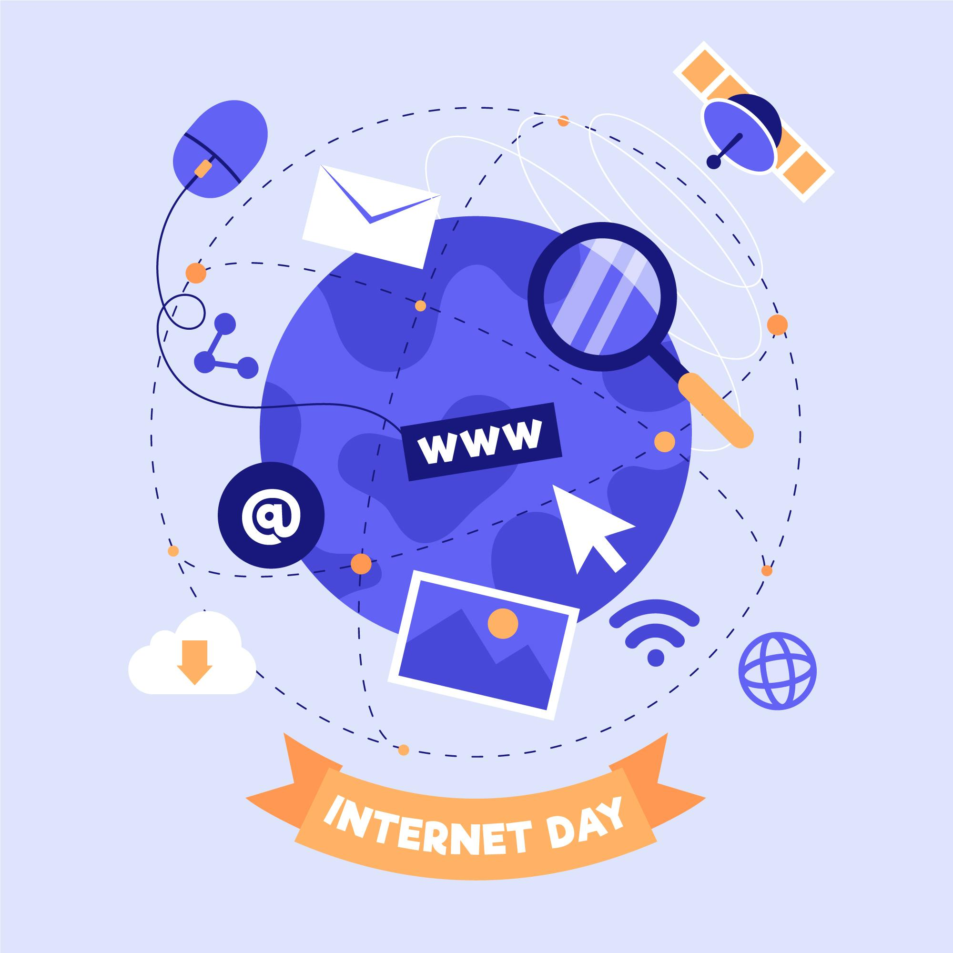
Importance of
INTERNET ?

Slide 3
1) Importance of Internet
2) Introduction to different Web generations?
i) WEB 1.0
ii) WEB 2.0
iii) WEB 3.0
3) WEB 3.0
i) Semantic Web
ii) Decentralization
iii) NFT's (Digital arts)
iv) 3D world or METAVERSE
v) Artificial Intelligence
vi) Ubiquiti web
4) Conclusion

Slide 4

Introduction to different generations of web.
1 . WEB 1.0 - The Read-Only web
WEB 1.0
WEB 1.0 the initiation of the Internet also known as the Read-Only web. During the year 1991, the Internet was made available for public use.

Slide 5
Introduction to different generations of web.
2 . WEB 2.0 - The Interactive Internet
WEB 2.0
In this world, on Internet, the user could not only consume data from the internet but was also able to feed data to the internet. This resulted in greater participation of users.

Slide 6
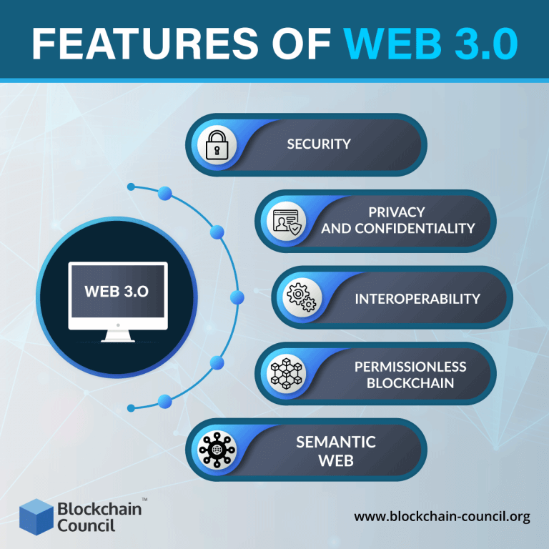
And finally, the
WEB 3.0, decentralized internet

Slide 7
Aspects of Web 3.0
: i) Semantic Web What is semantic web ?
Applications of semantic web
ii) Decentralization So what is Decentralization ?
What is blockchain?
What is mining crypto?
What are D-apps?
What are smart contracts?

Slide 8
Aspects of Web 3.0
iii) Blockchain
What is blockchain?
What is mining crypto?
What are D-apps?
What are smart contracts?
iii) NFT's What is a NFT ?
Types of NFT’s?

Slide 9
Aspects of Web 3.0
: iv) 3D world or METAVERSE
What is a Metaverse ?
Companies involved in Metaverse ?
v) Artificial Intelligence Applications of AI in Web 3.0
vi) Ubiquiti web
IOT

Slide 10
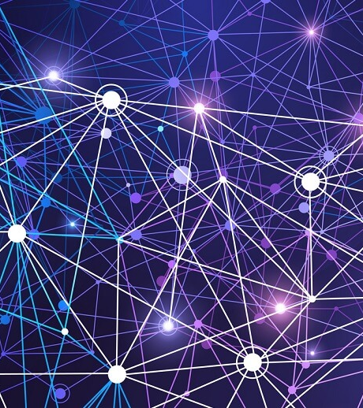
Semantic Web
Semantic web is a concept where machines could generate data and communicate with themselves. In the semantic web websites and apps would be able to generate and process data in a more human way and similar to human intelligence with the help of technologies like AI and ML..
Semantic web
A web of Emotions

Slide 11
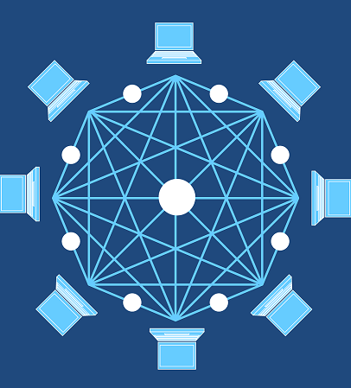
Decentralization
Instead of one server to process data as we had in web 2.0 this technology operates on a peer-to-peer where the user computer can interact directly with other computers without the use of an intermediary. So with this, the personal information of a person is not shared as a third party network has no access to this information just going from point A to point B.
Decentralized internet
Peer to Peer technology

Slide 12
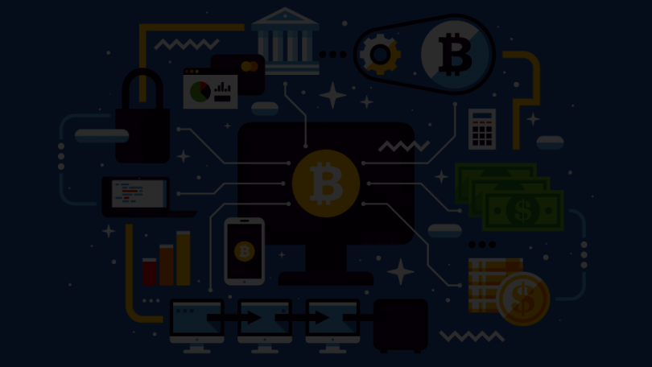
What is
BLOCKCHAIN ?
BLOCKCHAIN
A blockchain is a distributed database that is shared among the nodes of a computer network. As a database, a blockchain stores information electronically in digital format.
Features of Blockchain -
Immutability
Decentralized
Enhanced Security
Consensus

Slide 13
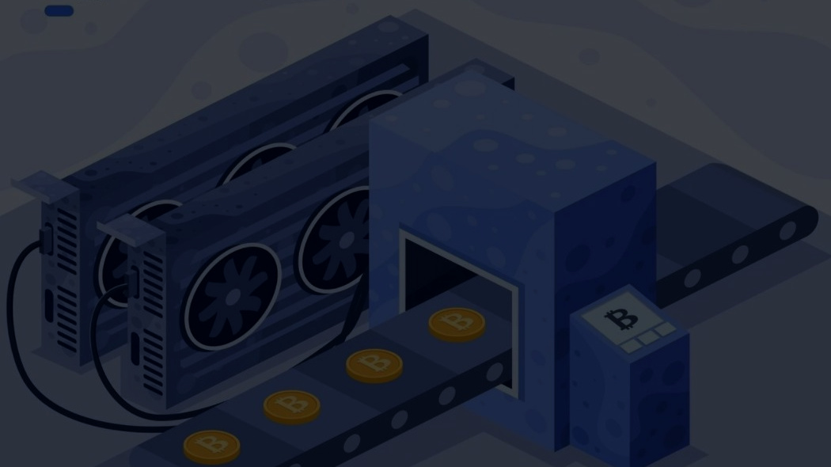
What is crypto mining ?
Crypto mining refers to the process of gaining cryptocurrencies by solving cryptographic equations with the use of high-power computers. The solving process comprises verifying data blocks and adding transaction records to a public record (ledger) known as a blockchain.

Slide 14
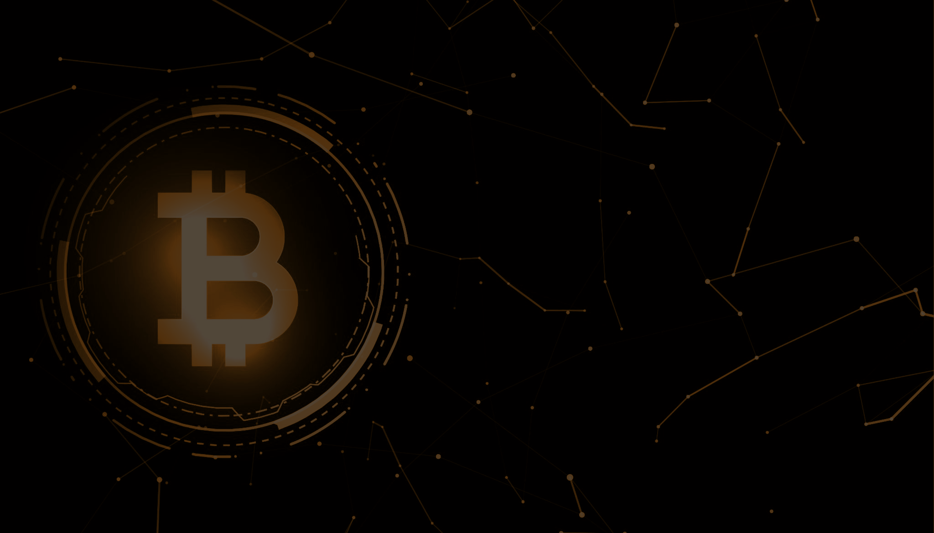
What are D-apps?
Decentralized applications (dApps) are digital applications or programs that exist and run on a blockchain or peer-to-peer (P2P) network of computers instead of a single server.

Slide 15
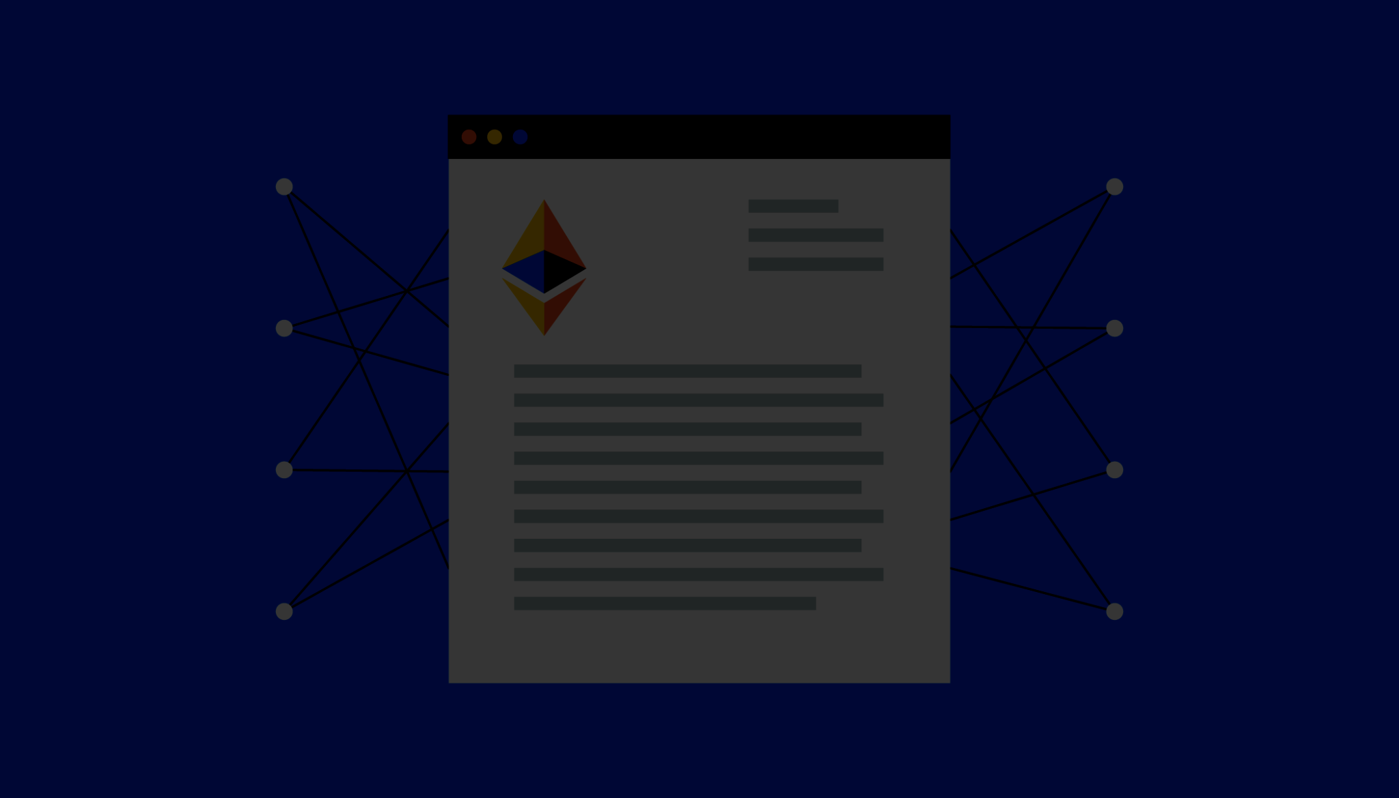
What are smart contracts?
Smart contracts are are simply computer programs stored on a blockchain that run when predetermined conditions are met. They typically are used to automate the execution of an agreement so that all participants can be immediately certain of the outcome, without anyone’s involvement or time loss.

Slide 16
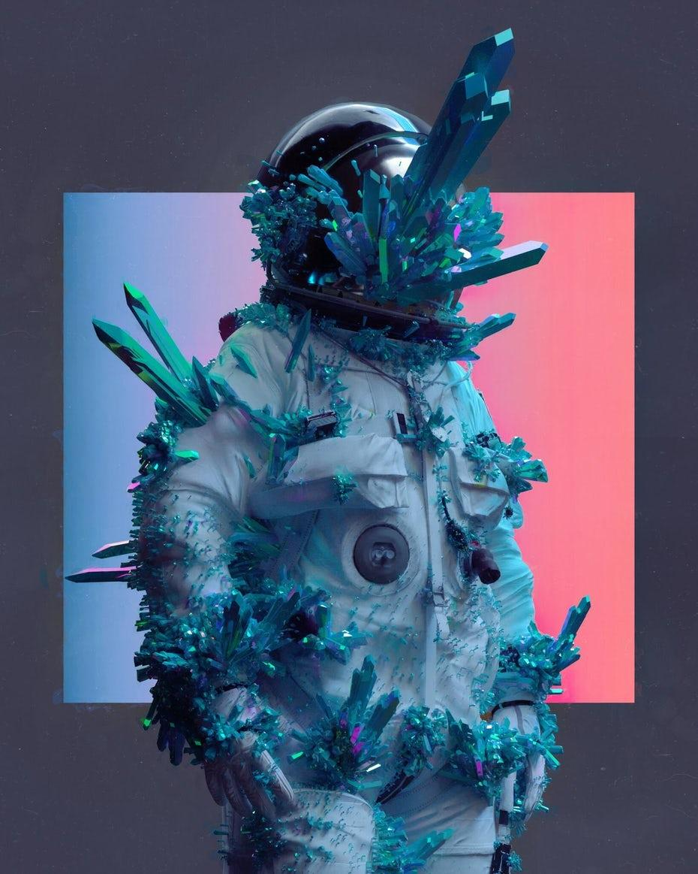
NFT’s
(Non Fungible Tokens)
NFT is another concept of web 3.0 which is spreading rapidly, a NFT is a Non-fungible token. A non-fungible token (NFT) is a unique and non-interchangeable unit of data stored on a blockchain.
NFT’s could be -
i) Art
ii) GIF
iii) Videos
iv) Visual avatara and video game skins
v) Music

Slide 17
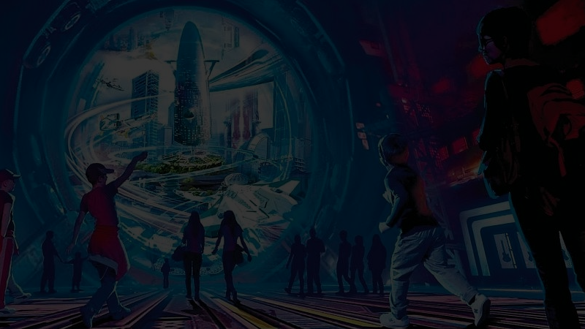
3D world or METAVERSE
A metaverse is an online virtual world that incorporates augmented reality, virtual reality, 3D holographic avatars, video, and other means of communication.
Metaverse
It is a whole new concept of future Social networking and Jobs

Slide 18
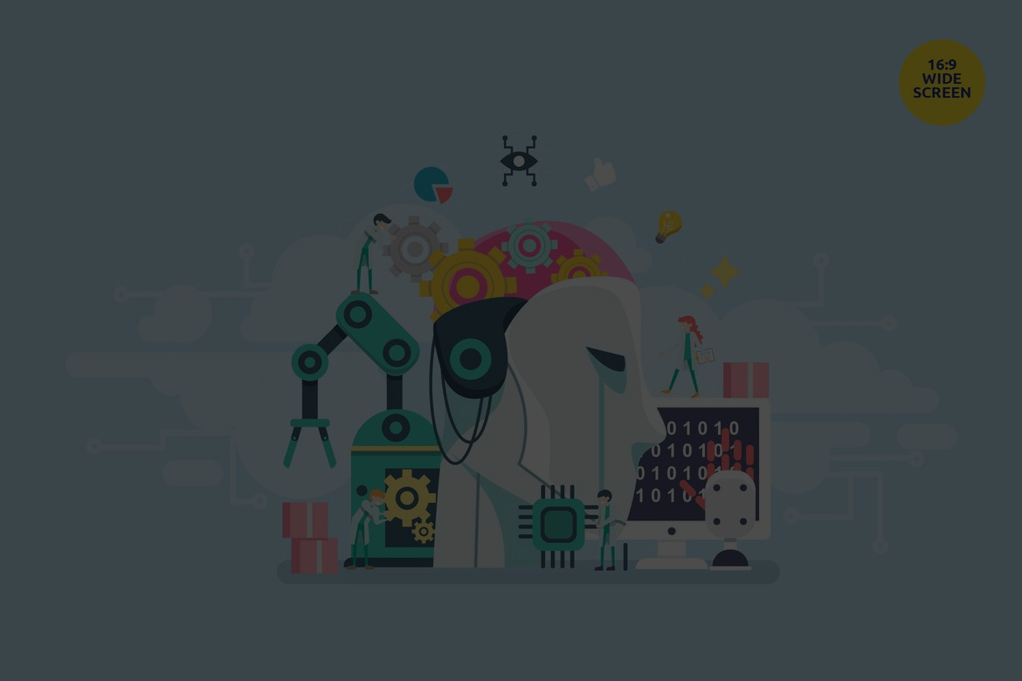
“ Artificial Intelligence will reach human intelligence by around 2029 “
Artificial Intelligence .
AI / ML
Although Web 2.0 presents similar capabilities, it is still predominantly human-based, which opens up room for corrupt behaviors.

Slide 19
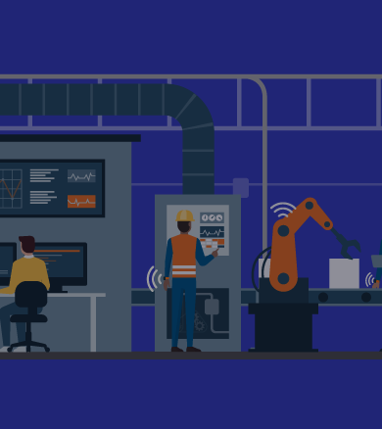
“ If you think that internet has changed your life, think again. The internet of things is about to change it all over again “
Ubiquiti Web
IOT
Web 3.0 simply takes this a step further by making the internet accessible to everyone anywhere, at any time.

Slide 20
Summary
Web 3.0
Web 1.0
Web 2.0
The decentralized web
The read only web
1990 - 2001 |  |  |  | 2002 - 2021
Present
The interactive web

Slide 21
Conclusion
The new internet will provide a more personal and customized browsing experience
It'll provide a smarter and more human-like search assistant
And other decentralized benefits that are hoped will help to establish a more equitable web

Slide 22

Thank You.

